Slide 1
SW Programming
20171105 이민욱

Slide 2
Problem modeling
Nov 3 – 1st presentation

Slide 3
Focus
The Degree of Accuracy
Scale Issue (Memory & Speed)

Slide 4
Get FileList
Pattern Search
Ranking
Sorting

Slide 5
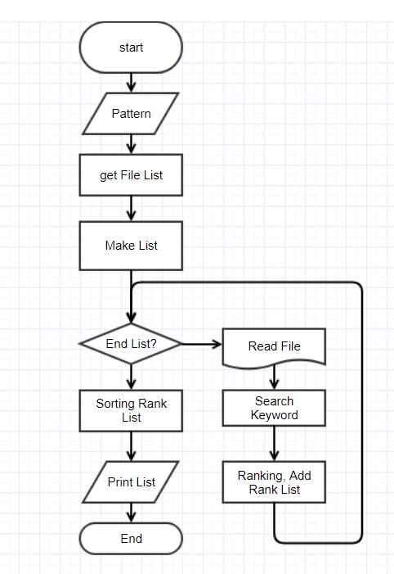
Flow Chart

Slide 6
Get File List
io.h
long _findfirst(char *filespec, struct _findata_at *fileinfo);
int _findnect(long handle, struct _finddata_t *fileinfo);
int _findclose(long handle);

Slide 7
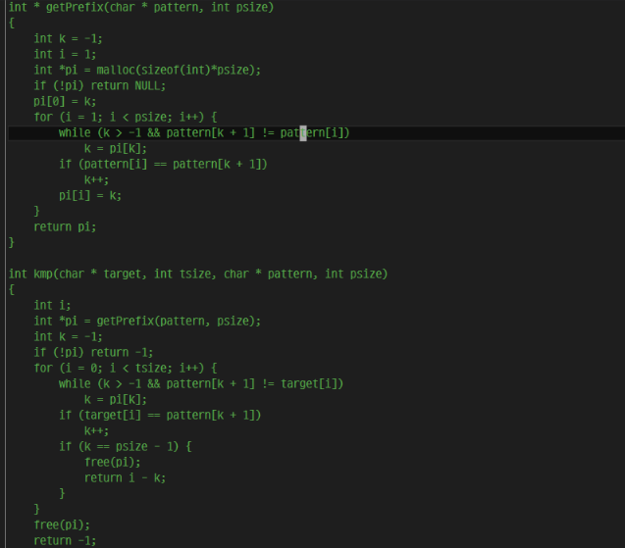
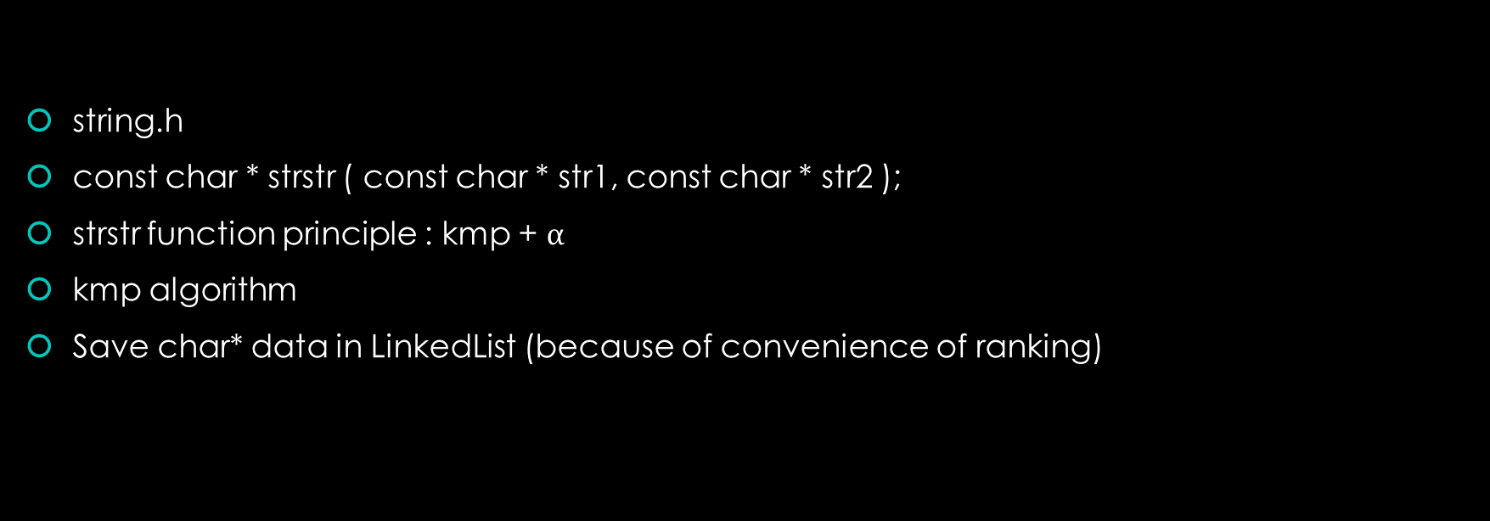
Pattern Search
string.h
const char * strstr ( const char * str1, const char * str2 );
strstr function principle : kmp + $α$
kmp algorithm
Save char* data in LinkedList (because of convenience of ranking)

Slide 8
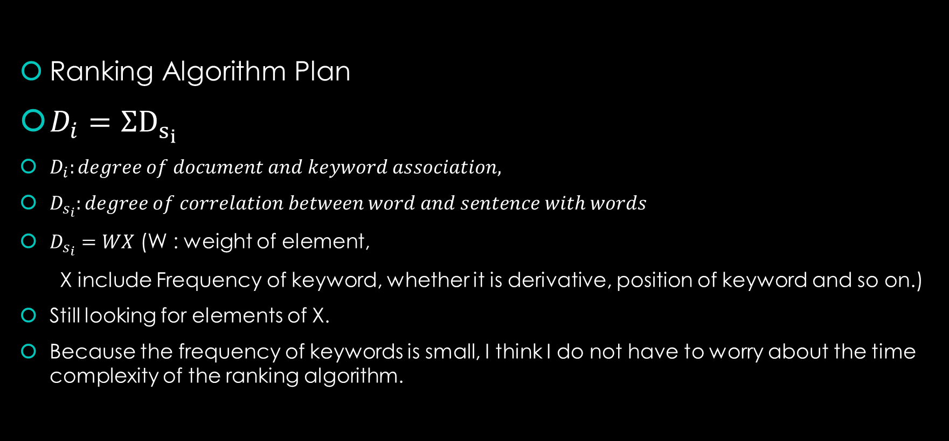
Ranking (The Degree of Accuracy)
Ranking Algorithm Plan
$D_{i}=ΣD_{s_{i}}$
$D_{i}:degree of document and keyword association,$
$D_{s_{i}}:degree of correlation between word and sentence with words$
$D_{s_{i}}=WX$ (W : weight of element,
X include Frequency of keyword, whether it is derivative, position of keyword and so on.)
Still looking for elements of X.
Because the frequency of keywords is small, I think I do not have to worry about the time complexity of the ranking algorithm.

Slide 9
Sorting
I use qsort.

Slide 10
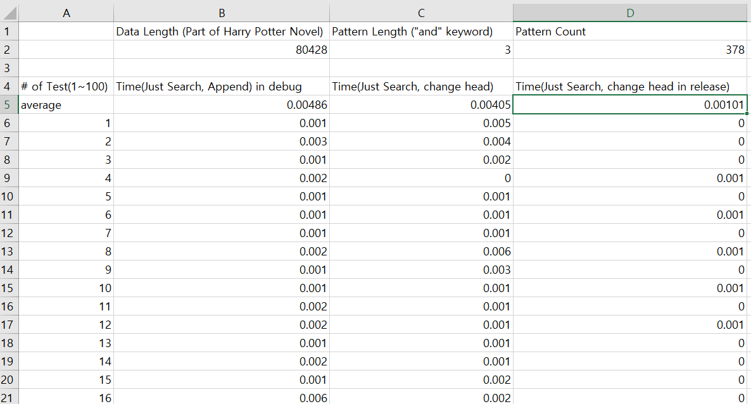
Is it really possible? (Scale Issue)
Toy Test
The length of time it takes to simply find?
(The decimal precision is up to the fifth decimal place.)
0.00405 (in Debug)
0.00101 (in Release)

Slide 11
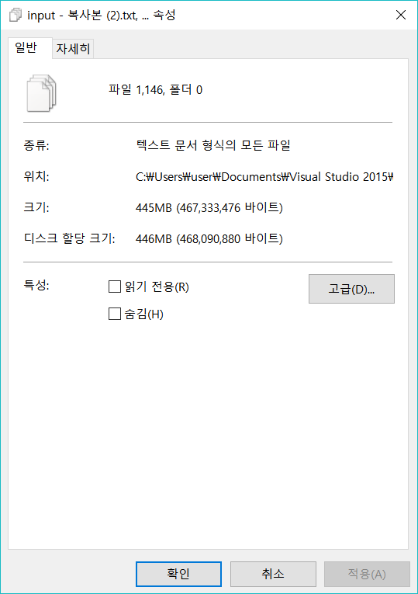
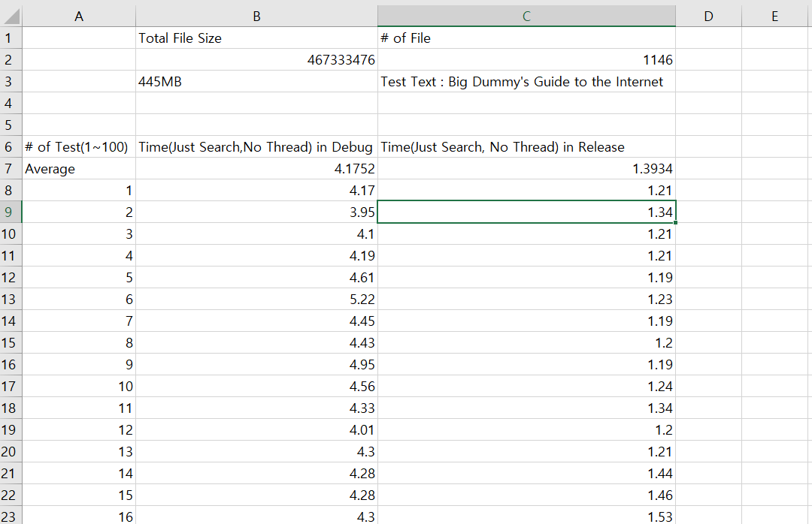
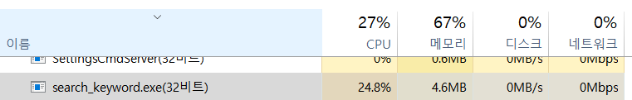
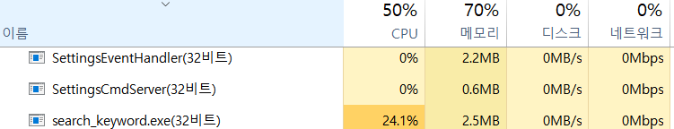
Is it really possible? (Scale Issue)
Loop 1~100
Debug
Release

Slide 12
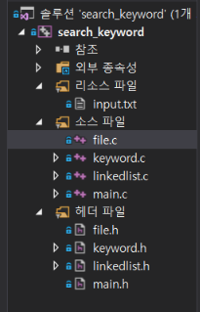
Source & Header File
Linkedlist : LinkedList structure, function
To do : sort list
Keyword : find keyword in document
To do : rank in document
File : Todo : get File list in directory
Todo : Distribute File list to Thread( If # of File > 1000)
Main : process argument
As of 10/28
As of 10/29

Slide 13
Algorithm & Solution
Nov 17 – 2nd Presentation

Slide 14
Algorithm?
Because my Algorithm use keyword position in sentence, I want to extract sentence!! \@^@/

Slide 15
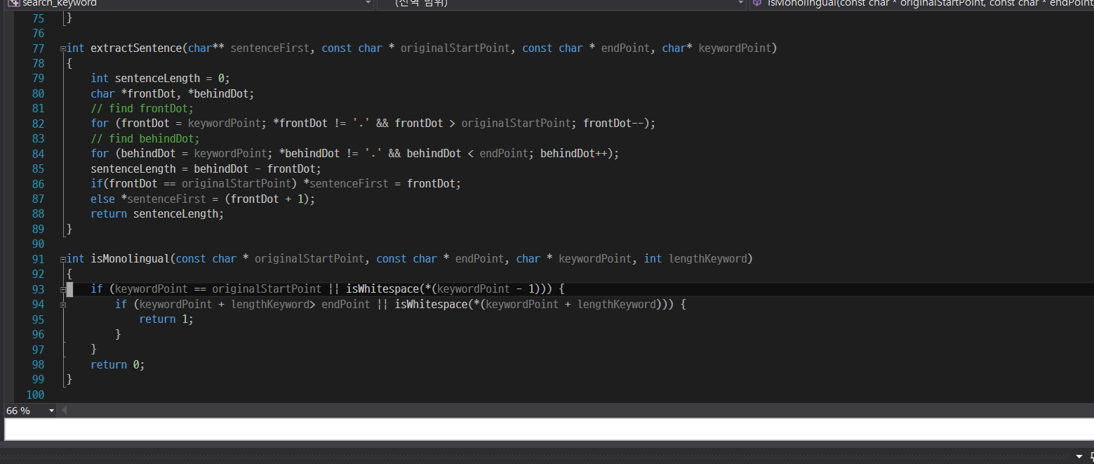
extractSentence

Slide 16
extractSentence
Sentence Point

Slide 17
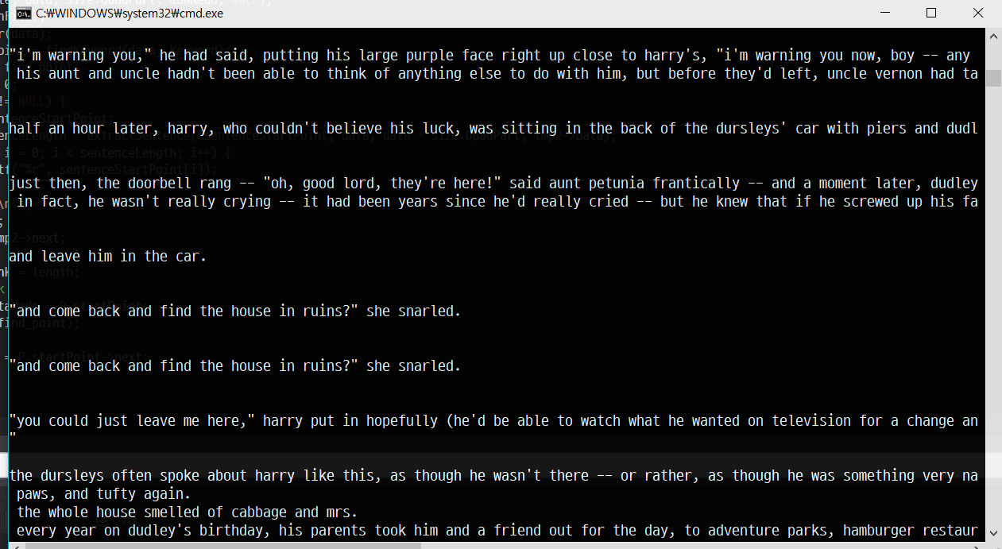
extractSentece test
Test Text is Harry Potter
And I know I should remove
Duplicate sentence.
or.. I think This situation is not too bad

Slide 18
Ranking (Remind)
Ranking Algorithm Plan
$D_{i}=ΣD_{s_{i}}$
$D_{i}:degree of document and keyword association,$
$D_{s_{i}}:degree of correlation between word and sentence with words$
$D_{s_{i}}=WX$ (W : weight of element,
X include Frequency of keyword, whether it is derivative, position of keyword and so on.)
Still looking for elements of X.
Because the frequency of keywords is small, I think I do not have to worry about the time complexity of the ranking algorithm.

Slide 19
Rank
Title : W is very very very large number (10e5)
Frequency : W = 10
Derivative : W = 5 (not sure)
Position of Keyword : Well… I don’t know, I’m reading Linguistic thesis…
maybe 0~2? The Sentence’s First word or, last word.
To be honest, the more I read linguistic thesis,
the more I think Title is best, Frequency is second best.. And other elements is no great significant.( I tested wikipedia data)

